Slide 1
GROUND UP A RETAIL APP FROM SCRATCH
SEATTLE TECHNOLOGY DEVELOPMENT CENTER
JANUARY 2016

Slide 2
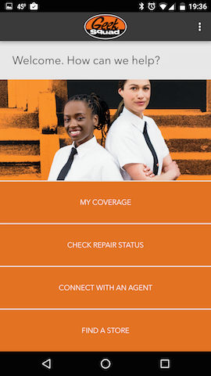
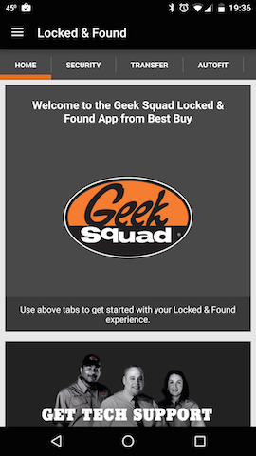

WELCOME!
STDC
Geek Squad – Before and After
Notes:
STDC Purpose
GS – Old GS -> GS L&F

Slide 3
General app architecture pattern
Views
Network
Cloud
Local Store
Notes:
Service team
Existing APIs
Simple, (mostly) read-only app

Slide 4
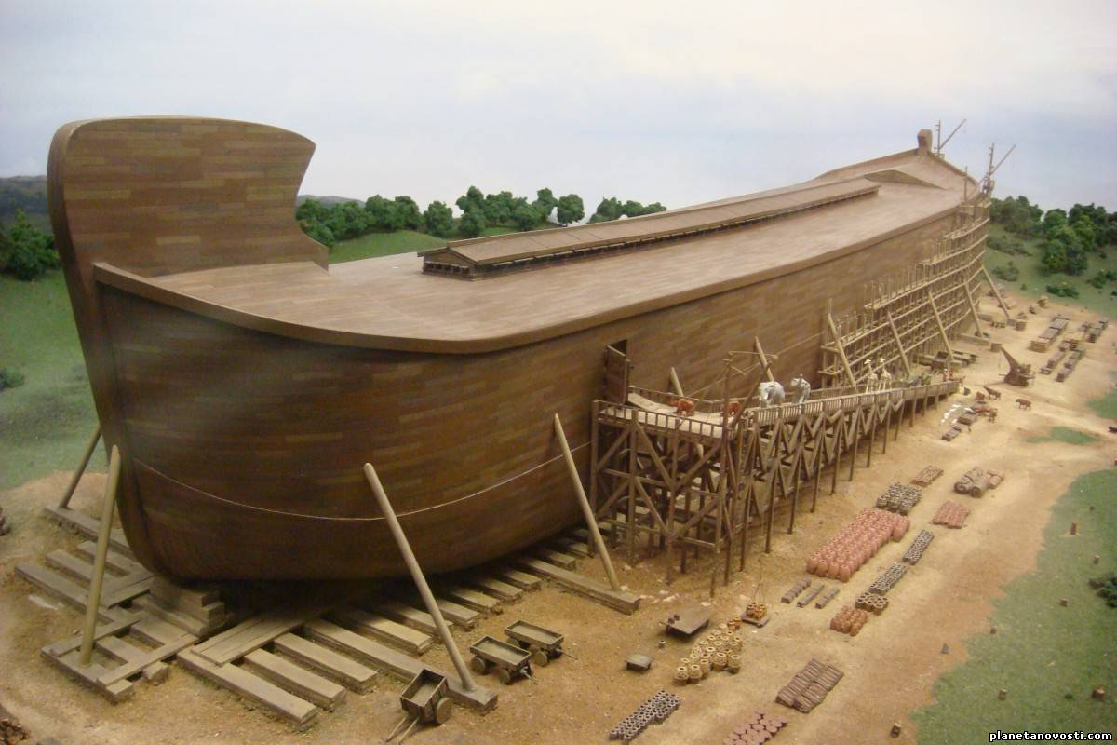
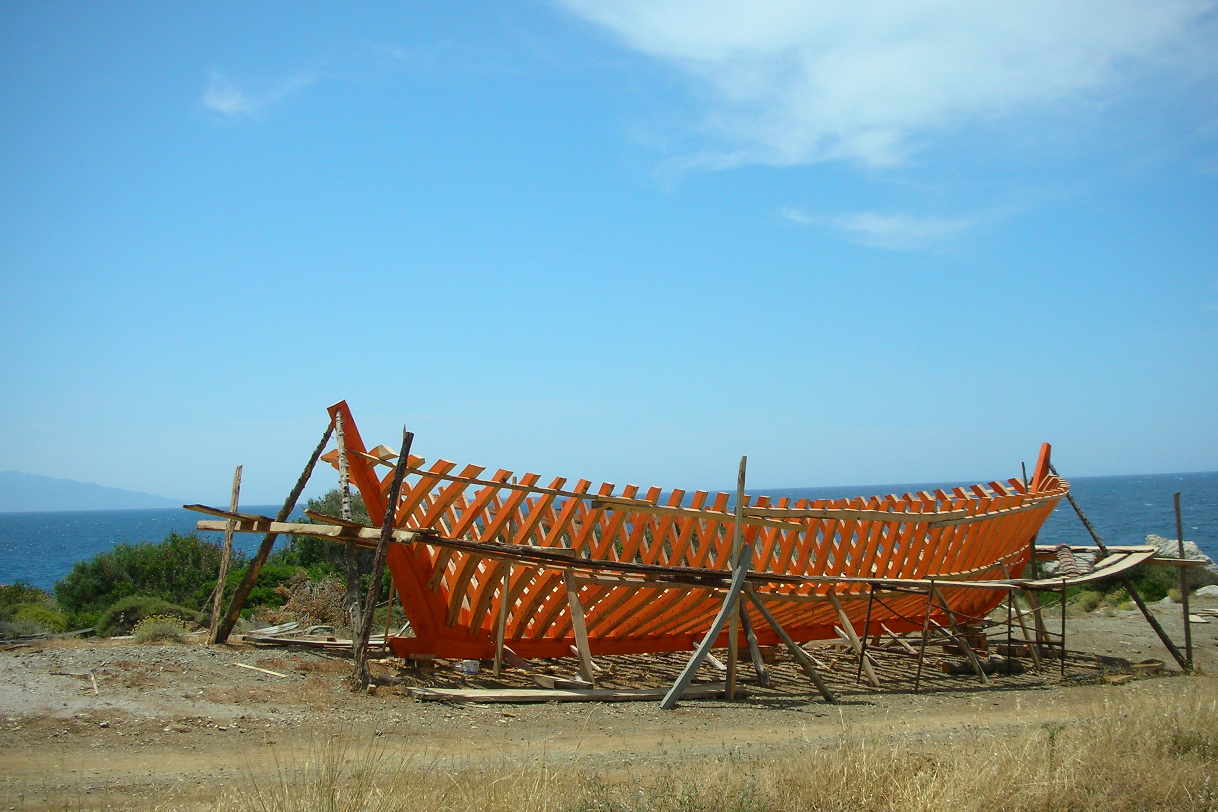
Basic Project setup
Notes:
minSDK
Junk in AS generated project
Cleanup
Result

Slide 5
NETWORKING
HttpUrlConnection + AsyncTask
OkHttp
Retrofit
Retrofit pattern code drove us to use distinct request classes.
Retrofit issues prior to 2.0: empty post bodies and multiple domains instead of multiple paths
Overall architecture led to difficulties in determining current state of request and requires additional code to solve
Volley
Notes:
Previous AsyncTask implementation
“Best code is code I don’t have to write”
Wanted more than just a network layer
Performance
Winner

Slide 6
LOCAL DATA
SQLite
Realm
Additional model requirements for our fat API responses
No back-linking support
Migration
Breaking updates
Notes:
Previous exposure to Realm on iOS
Android SDK not as mature but still in production
----
Model requirements for our verbose API response
No back-linking support

Slide 7
LATECOMERS
Butterknife
Otto
Picasso
Notes:
Cleaner code

Slide 8
BUILDING
Flavorful
Automated
Frequent
Identifiable
Notes:
Pleasure
Build servers
On-commit builds
Out to AS:
- Version code generation (make sure the count will last)
- File naming

Slide 9
OTHER CONSIDERATIONS
Testing
Enterprise SMEs
Existing service APIs
Notes:
Base testing skeleton for unit and integration tests
Making sure to have the right people in the comms loop
Dealing with existing APIs and working for changes to them

Slide 10
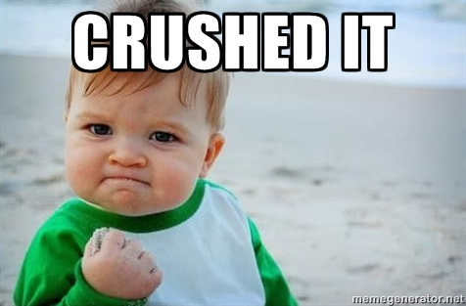
END GAME
Notes:
Thanks – Kathryn, Scott, Chris P, everyone

